Slide 1
Using the Superpower R package to simulate power
Aaron Caldwell
Thermal and Mountain Medicine Division
United States Army Research Institute of Environmental Medicine

Slide 2
Disclosures
The opinions or assertions contained herein are the private views of the author(s) and are not to be construed as official or reflecting the views of the Army or the Department of Defense. Any citations of commercial organizations and trade names in this report do not constitute an official Department of the Army endorsement of approval of the products or services of these organizations. No authors have any conflicts of interest to disclose. Approved for public release; distribution is unlimited

Slide 3
Quick Refresher
In frequentist statistics we are typically concerned with 2 errors: Type 1 and 2
Think 1 = False Positive and 2 = False Negative
We then try to control these errors through setting an acceptable alpha (α) and beta (β).
Statistical power (1-β) is a hypothetical probability of detecting an effect of a certain magnitude
No effect = alpha level (e.g., 5%)
Why do we care about these numbers?
We want studies to find effects if they do exist
If we are interested in a small effect and collect a small sample size, we are unlikely to detect an effect (at least with a low alpha level)
There is no free lunch in statistics (Bayesian or otherwise)

Slide 4
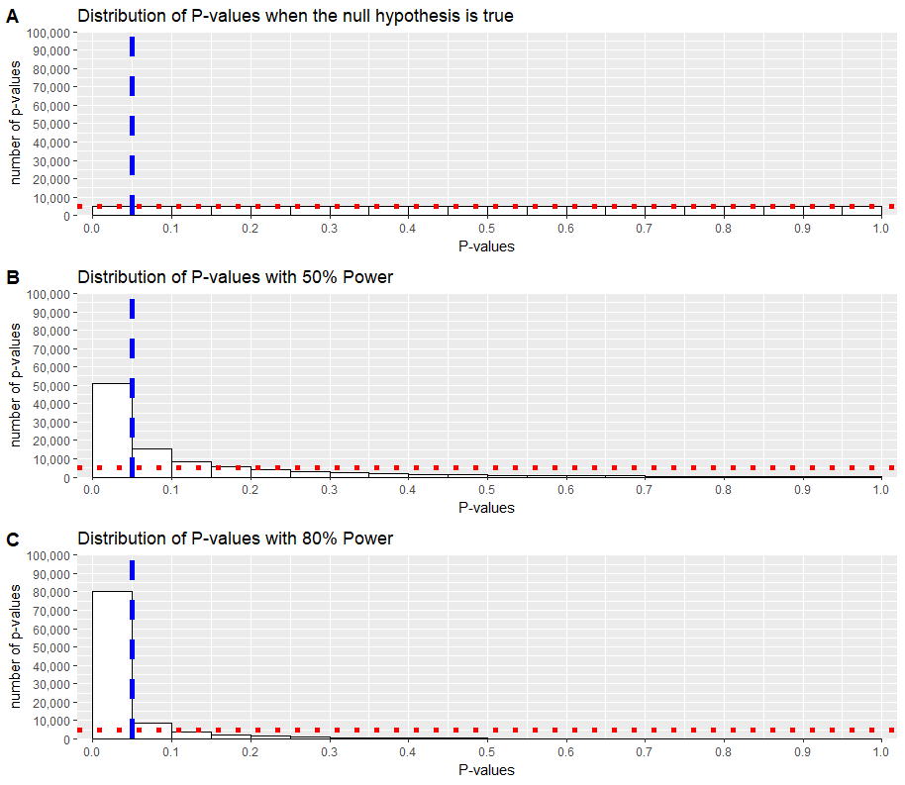
Visualization

Slide 5

Traditional Power Analysis
Effect size of interest needs to be defined
Cohen’s d (standardized mean difference)
Should almost never be a previously observed effect
Alpha and Beta/Power are then selected
Sample Size is given as output
Gpower example

Slide 6

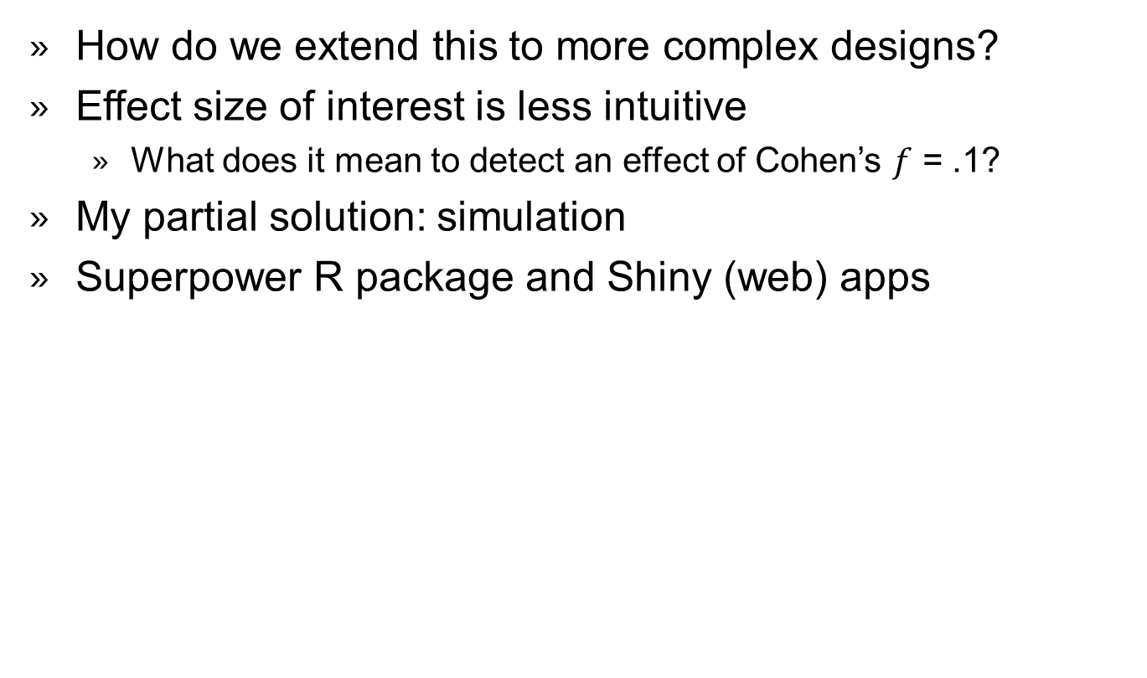
Common Problem
How do we extend this to more complex designs?
Effect size of interest is less intuitive
What does it mean to detect an effect of Cohen’s $f$ = .1?
My partial solution: simulation
Superpower R package and Shiny (web) apps

Slide 7
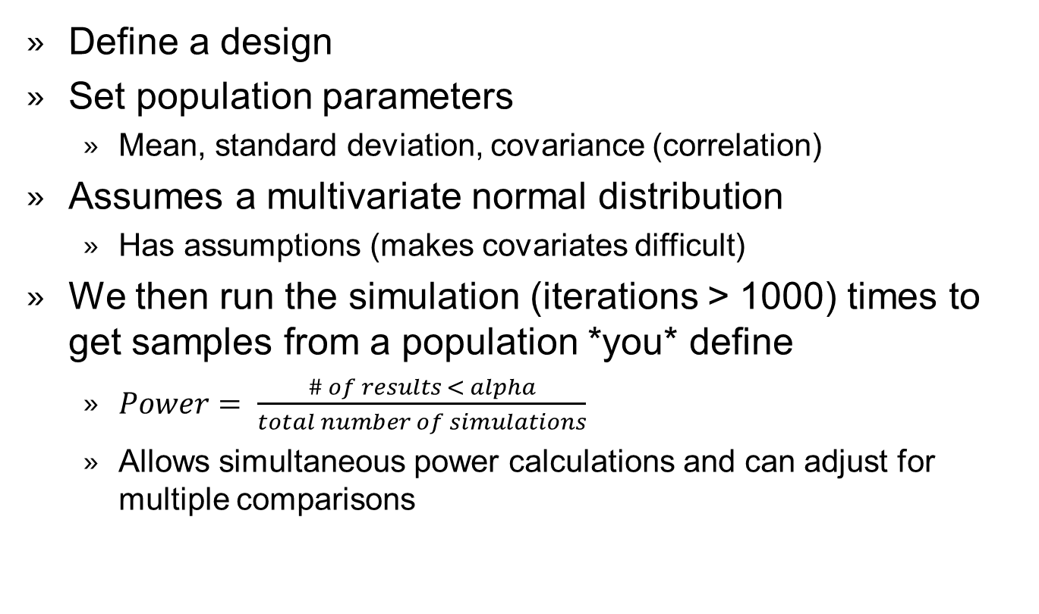
How does this work? Pt. 1
Define a design
Set population parameters
Mean, standard deviation, covariance (correlation)
Assumes a multivariate normal distribution
Has assumptions (makes covariates difficult)
We then run the simulation (iterations > 1000) times to get samples from a population *you* define
$Power= \frac{\# of results < alpha}{total number of simulations}$
Allows simultaneous power calculations and can adjust for multiple comparisons

Slide 8
Example #1
We can use the Shiny App
www.arcstats.io/shiny/anova-power

Slide 9
How does this work? Pt. 2
Another option is to use an “empirical” distribution
Essentially means the parameters will be the sample estimates
Much faster but comes with costs
Limitation 1: Complex designs can’t have small sample sizes
Limitation 2: No corrections for multiple comparisons

Slide 10
Exact Example
Shiny Web App
www.arcstats.io/shiny/anova-exact

Slide 11
Key Questions
Most common question:
“But Aaron, how do I know what my means, standard deviations, or correlations should be!” – Good Question
Remember: power is a hypothetical probability
So, be skeptical and select reasonable parameters.
What would the most skeptical reviewer think?
Presentation to funding agencies, or IRBs, will be much more straightforward.
“Given these parameters, we expect to have adequate (X%) power with a sample size of X per group and an alpha-level of Z.”
This way you are presenting your entire design
Rather than a non-intuitive standardized effect size

Slide 12
Balance Alpha and Beta
Researchers should also consider alpha and beta levels as dynamic qualities in study design
Current standard implies type 1 errors are 4 times as costly
May not be the case in many fields (my own included)
Calculating the weighted combined error rate as an alternative
http://shiny.ieis.tue.nl/jya/
https://arcstats.io/shiny/justify/

Slide 13
Concluding Remarks
Simulation is a powerful tool for estimating power
Not limited to power
Also great to see how “violating assumptions” affects models
A great way to setup your analysis pipeline
You can use the code in your simulation for your later analyses!
Bayesian or “Accuracy” based alternatives
Both can be simulated
Don’t forget to justify your alpha (and power)!
Not fixed values

Slide 14
Question
How can we achieve good power in both main effects and interactions (and post hoc comparisons)?
My suggestion: find the comparison of interest with the smallest effect size and power your study to detect that effect. You also may want to adjust the alpha for each comparison to balance or minimize error rates.
Do you have any tips for power estimation in regression?
My suggestion: write custom code (I prefer the simstudy package) and then simulate to get an accurate estimate of power (simr package may be useful).

Slide 15
Questions
How to interpret effect sizes of interactions or factors with more than 2 levels? Does it make sense to report them at all?
Yes, but this entirely depends upon what you are trying to illustrate.
Options include partial η² or Cohen’s f
partial η² represents a ratio of the effect to total variance (bound between 0 and 1)
Cohen’s f is a ratio of the population variances (sample size invariant noncentrality measurement)
Mean Differences may be more useful

Slide 16
Questions
How do we estimate the mean and SD parameters for a complicated design such as 3 x 3 x 2 ANOVA? Any tips to enter the parameters in order to mirror the effect sizes in mind?
To the code!
https://aaroncaldwell.us/SuperpowerBook/power-for-three-way-interactions.html

Slide 17
Questions
When conducting experiments with certain very rare populations (rare diseases e.g.) reaching appropriate sample sizes for high power is at least not feasible and, in some cases, even impossible. We would be interested in tips or insights on this specific obstacle.
Compromise!
https://arcstats.io/shiny/justify/

Slide 18
Questions
How do I consider the number of trials and stimuli in power calculations? The intuitive understanding of it is that these parameters do influence the power estimation (via reliability. But we can calculate the ICC mostly post hoc, if any.) For linear mixed models, for example, there can be a trade-off between N of participants and N of items. Is there a way to consider it for ANOVA?
I would recommend against an ANOVA!
R packages: simstudy and simr
It is complicated!

Slide 19
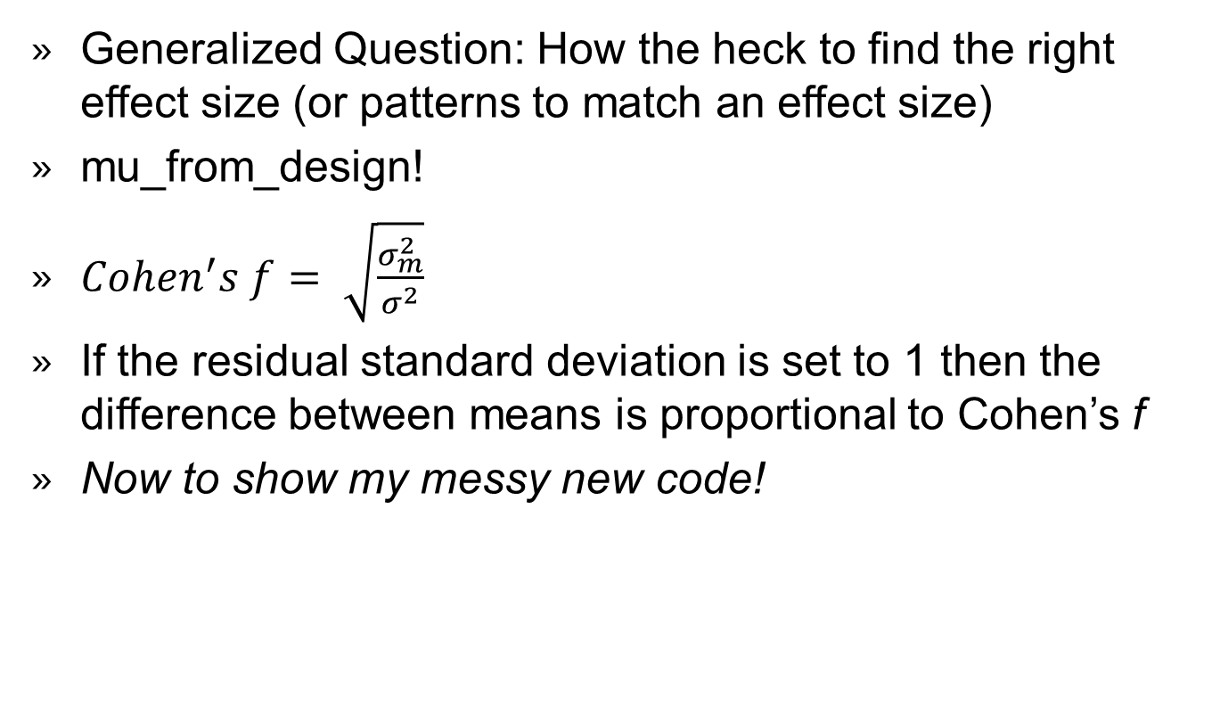
Questions
Generalized Question: How the heck to find the right effect size (or patterns to match an effect size)
mu_from_design!
$Cohen^{′}s f= \sqrt{\frac{σ_{m}^{2}}{σ^{2}}}$
If the residual standard deviation is set to 1 then the difference between means is proportional to Cohen’s f
Now to show my messy new code!

Slide 20
Questions
Time Series Data
Rely on simstudy + for loops (or apply functions)
https://kgoldfeld.github.io/simstudy/articles/longitudinal.html

Slide 21

Thank You
USARIEM
Thank you to my colleagues at TMMD for their patience when I babble about simulation
Special thanks to my mentor Nisha Charkoudian
Collaborators
Daniel Lakens
Frederick Aust
Lisa DeBruine
Ronna Turner

